Slide 1
Stout Risius Ross Pricing Energy Derivatives
MIT Finance Research Practicum
February 27, 2015

Slide 2
Agenda
Energy Commodity Market Background
Spread Option Overview
Spread Option Pricing Model
Multifactor Model
Principle Component Analysis

Slide 3
Background on the Energy Commodity Market
Crude oil – WTI (West Texas Intermediate), Brent
Heating oil
Other refined oil product
Natural gas
Electricity

Slide 4
Energy Commodity Properties
Seasonality
Seasonal demand and supply
Unexpected events and natural disasters
Mean reversion
Equilibrium price determined by demand and supply
Convenience yield and storage cost
Heavily influenced by social/economic change
Technology and production capability
Regulatory policy, foreign policy

Slide 5
Spread Option
A spread option is an option written on the difference of two underlying assets
Suppose asset values at time t are S₁(T) and S₂(T), then intrinsic value for a spread call option is
Max( S₂(T) – S₁(T) – K, 0)

Slide 6
Types of Spread Option
Dark spread: electricity and coal
Spark spread: electricity and gas
Crack spread: crude oil and its refined products
Temporal spread: same underlying but with different maturity dates
Locational spread: same underlying but with different physical delivery locations

Slide 7
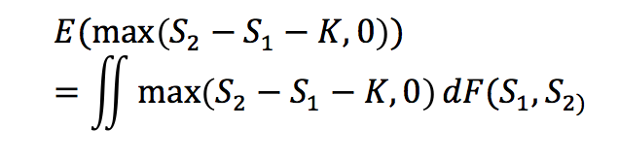
Valuing Spread Option
Under risk neutral probability
No closed-form solution is derivable because of this double integral
Our goal: explore various ways to evaluate a generic spread option

Slide 8
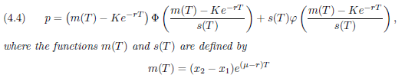
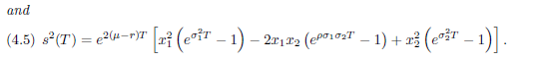
Bachelier Model
Assumption: the dynamics of a spread follows an arithmetic Brownian motion
This assumption restricts the value of underlying asset to be positive, so that the spread option price can be computed by evaluating Gaussian integrals
Gaussian integrals can be represented by a closed form formula, similar to the Black Scholes formula

Slide 9
Carmona-Durrleman Procedure
Built on Geometric Brownian motion of the two underlying forward prices, and utilizes trigonometric functions to evaluate the option
As a result, a model similar to the Black-Scholes formula is sufficient to find the approximated option value. When strike price K=0, this model reduces to the Margrabe model.

Slide 10
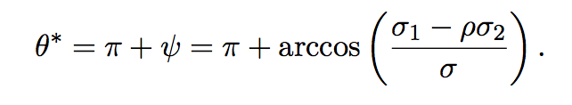
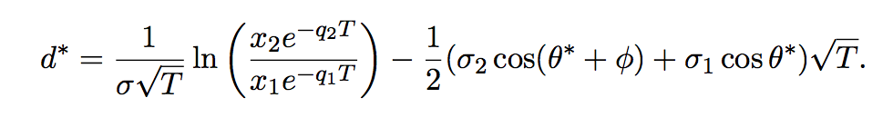
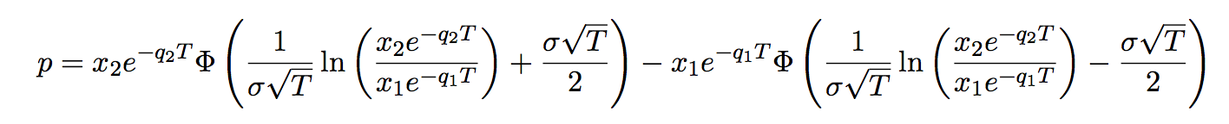
Carmona-Durrleman Procedure
Defines a lower bound approximation and maximize over parameters θ and d
And finally,

Slide 11
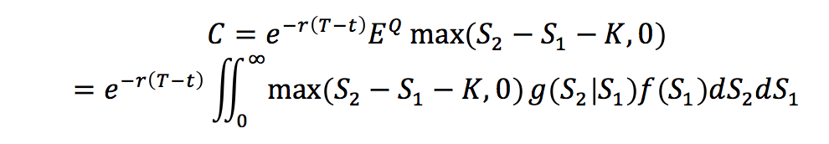
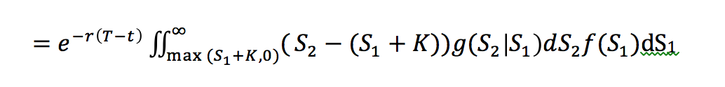
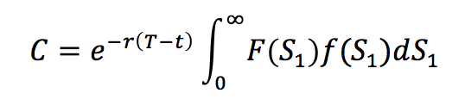
Pearson Model
Reduces the double integral to single integral by parameterizing S₂ to the product of conditional density
G(S₂|S₁) and log-normal distribution function f(S₁)
Assumptions:
2 underlying assets are log-normally distributed
Risk neutrality Q

Slide 12
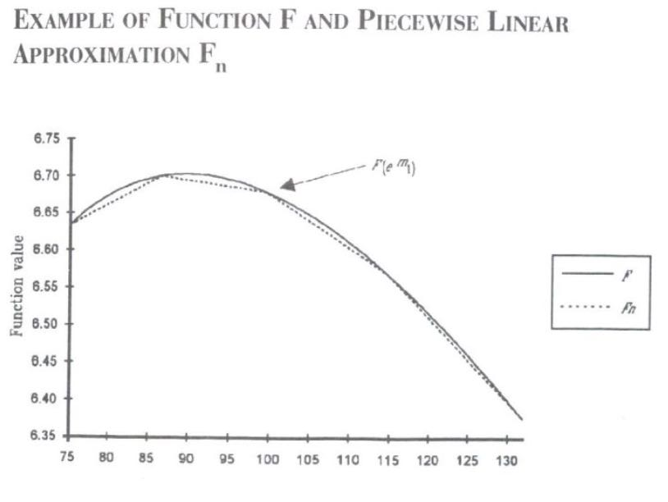
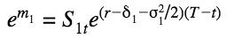
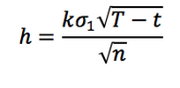
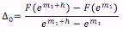
Pearson Linear Approximation
Further simplifies the single integral by partitioning linear piecewise functions along the curve
Area under the graph divided into 2n

Slide 13
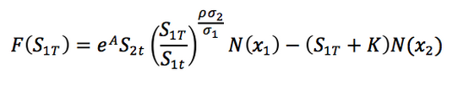
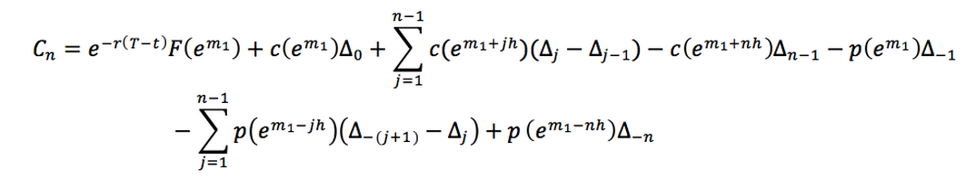
Pearson Linear Approximation

Slide 14
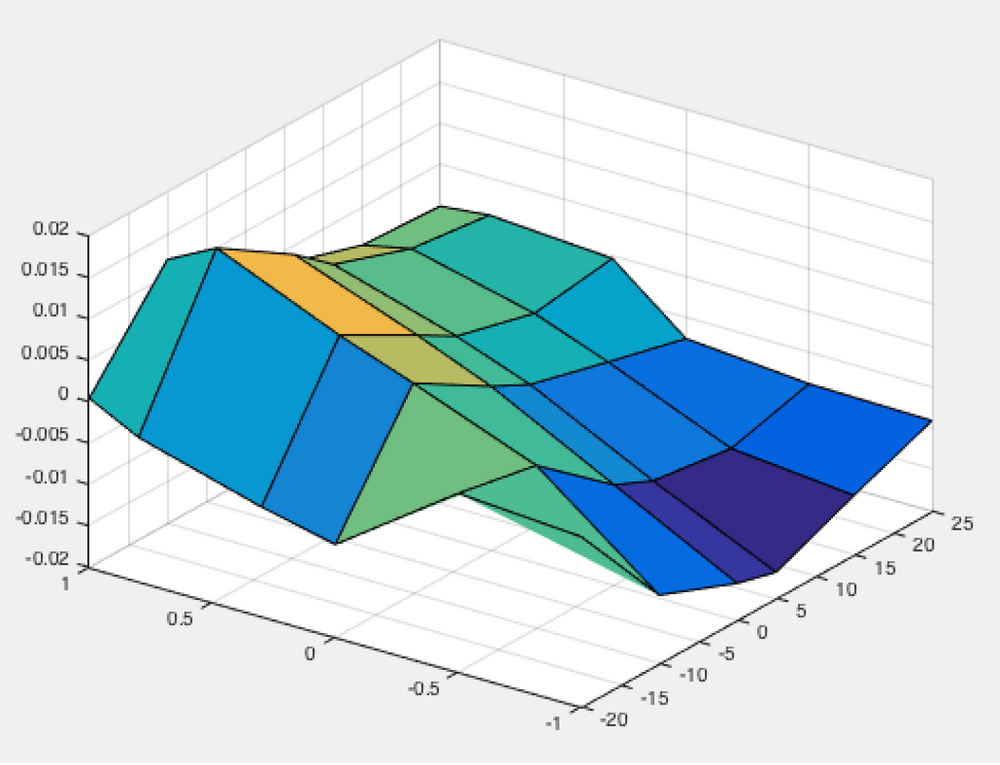
Pearson Optimization
Optimized values:
n = 32
k = 1.04
Error = 0.00216

Slide 15
Testing Results and Comparison
Testing data:
F1 = 103.05, F2 = 112.22
Annualized volatilities V1 = 15%, V2 = 10%
Annualized risk free rate Rf = 5%
Time to maturity of the spread option T = 1
Generate a table according to different combinations of
strike K ranging from -20 to 25
correlation C12 ranging from -1 to 1

Slide 16
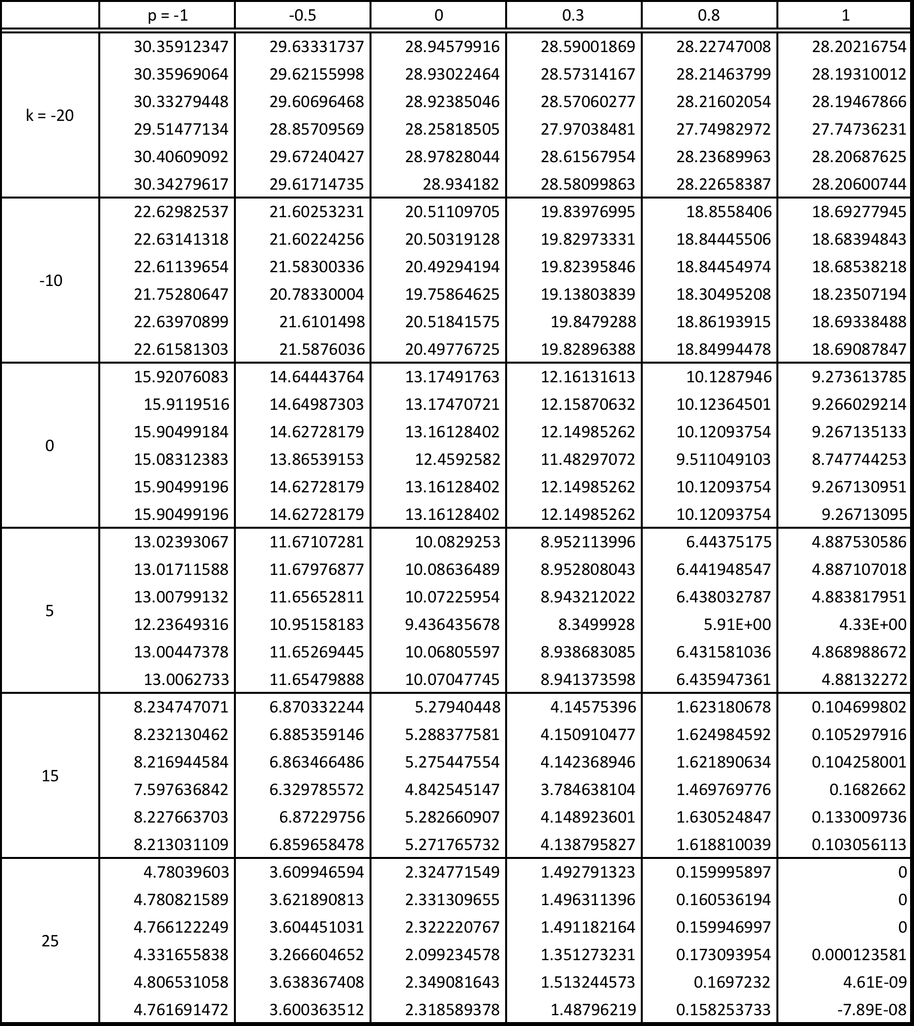
Model Results
Order:
1. Monte Carlo Simulation 2. Optimized Pearson Linear Approximation
3. Pearson Integration
4. Bachelier Model
5. Kirk Approximation
6. Bjerksund and Stensland model

Slide 17
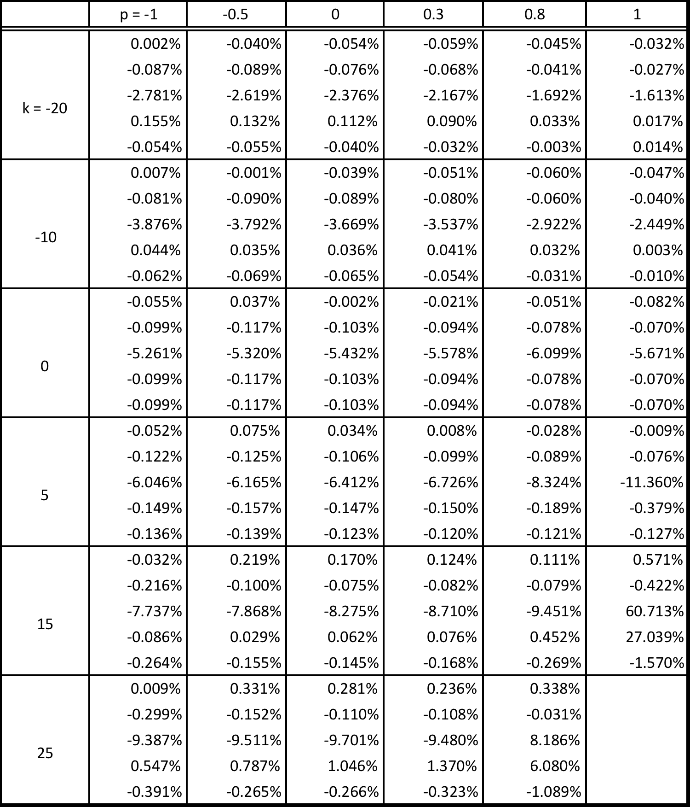
Percentage Errors
Order:
1. Optimized Pearson Linear Approximation
2. Pearson Integration
3. Bachelier Model
4. Kirk Approximation
5. Bjerksund and Stensland model

Slide 18
Spread Option Summary
Pearson Integration and Bachelier Model generally underprice the option except when the strike is large and correlation is close to 1
Kirk Approximation seems to overprice the option when strikes is away from zero, and underprice when the strike is closer to 0
Bjerksund and Stensland Model appears to always underprice the spread option except when the strike is -20 and correlation is 1
Overall, the Pearson approach is the most accurate model to our spread option price when the strike is high and the two assets are highly positively correlated.

Slide 19
Multifactor Model
Schwartz Two-Factor Model
Spot price: Ito’s process
Convenience yield
Assumption:
two factors have a joint Gaussian distribution
log-normally distributed spot price
Schwartz-Smith Two-Factor Model
Short term deviation
Long term equilibrium

Slide 20
Schwartz and Smith 2-Factor
The change in long maturity future prices gives information about the change in equilibrium price.
The change in difference between near- and long-term future prices gives information about the change in short-term deviation
Short-term deviation
Mean reversion to 0 – OU process
Long-term equilibrium
Geometric Brownian motion with a drift

Slide 21
Model Intuition

Slide 22
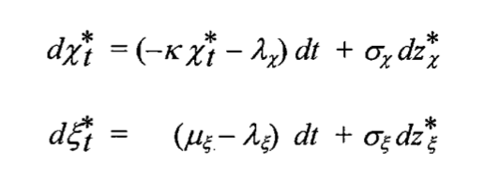
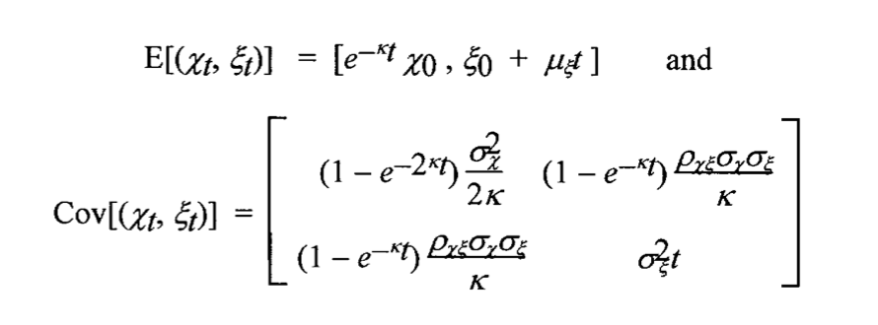
Schwartz-Smith Two Factor Model

Slide 23
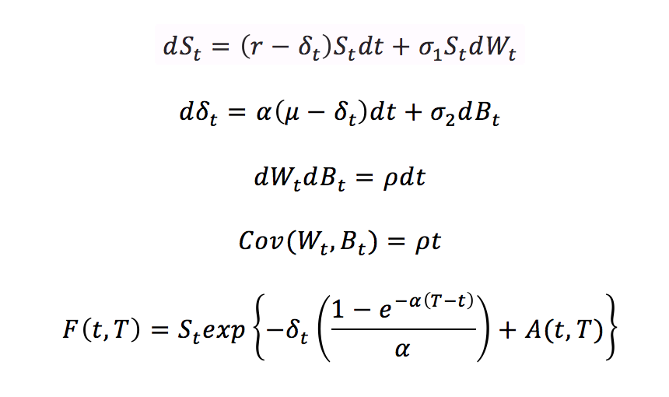
Schwartz Two Factor Model

Slide 24
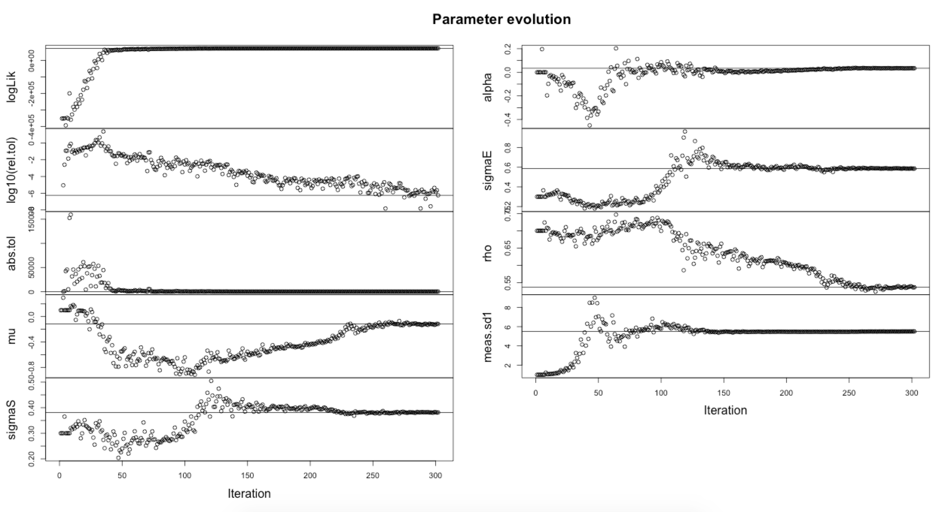
Results: Parameter Estimation

Slide 25
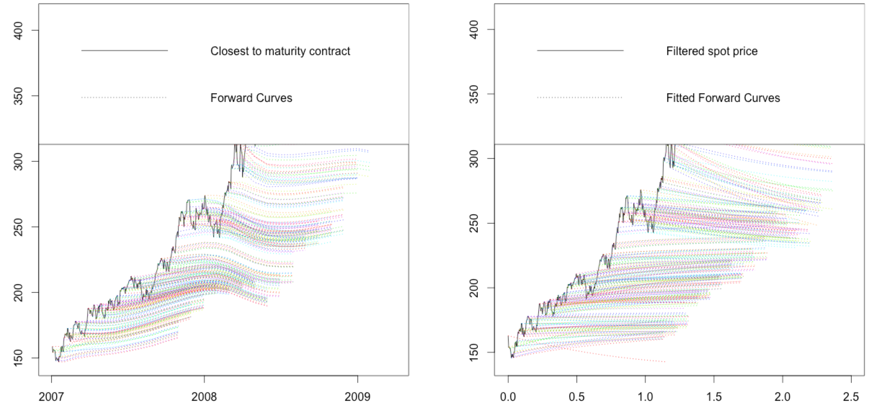
Results: Heating Oil Futures Curve

Slide 26
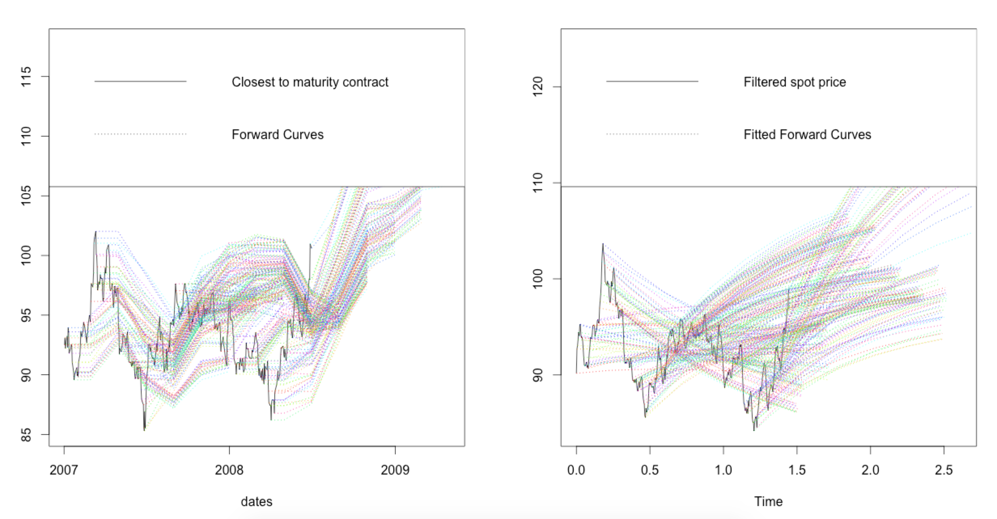
Results: Cattle Futures Curve

Slide 27
Multifactor Model Summary
Two-factors over fitting historical data
Kalman Filtering smooth term structure
Does not incorporate seasonality at all
Unclear definition of time horizon

Slide 28
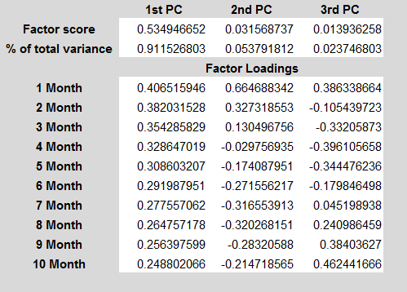
PCA Model
A tool commonly used for dimensionality reduction
Step1: Find covariance matrix on log returns of historical heating oil future prices
Step2: Eigenvalue-decompose the matrix and find top 3 factor scores and their corresponding eigenvectors
Step3: Compute % of total variance explained
Total data range: 1/3/1995 - 9/7/2010

Slide 29
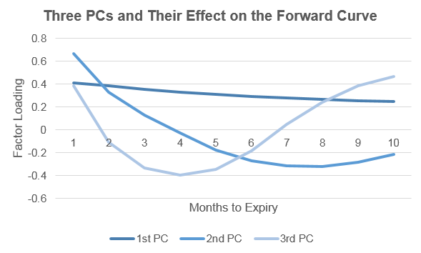
Three Major Factors for the Forward Curve
Similar to the fixed income market, the commodity market can also be explained by the three major risk factors: level, slope, and curvature

Slide 30
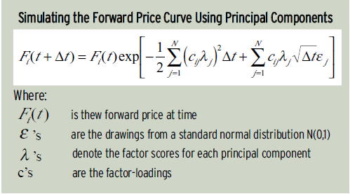
Simulating the Forward Curve Using Principal Components
Paper published by Financial Engineering Associates on Multi-Factor Models of the Forward Curve
Once we have computed the factor scores and factor loadings, we can use the results to simulate the forward curve
PCA reduces the covariance matrix into 3 subsets of uncorrelated variables. Its factor score is a contribution of the source of risk to the volatility of the forward price.

Slide 31
Historical vs. Model Implied
(monthly)
(monthly)
Time (daily): 1/3/1995 - 11/3/1999
Time (daily): 1/3/1995 - 11/3/1999
Source: NYMEX HO Comdty Data from Bloomberg

Slide 32
Conclusion
1. Pearson
2. Bachelier
3. Carmona-Durrleman
4. Kirk Approximation
5. Bjerksund and Stensland model
6. Monte Carlo Simulation
Spread Option Valuation
Pearson Model
Forward Curve Simulation
1. Schwartz Two-Factor
2. PCA
Add Seasonality

Slide 33
Q&A
Thank You

